Slide 1
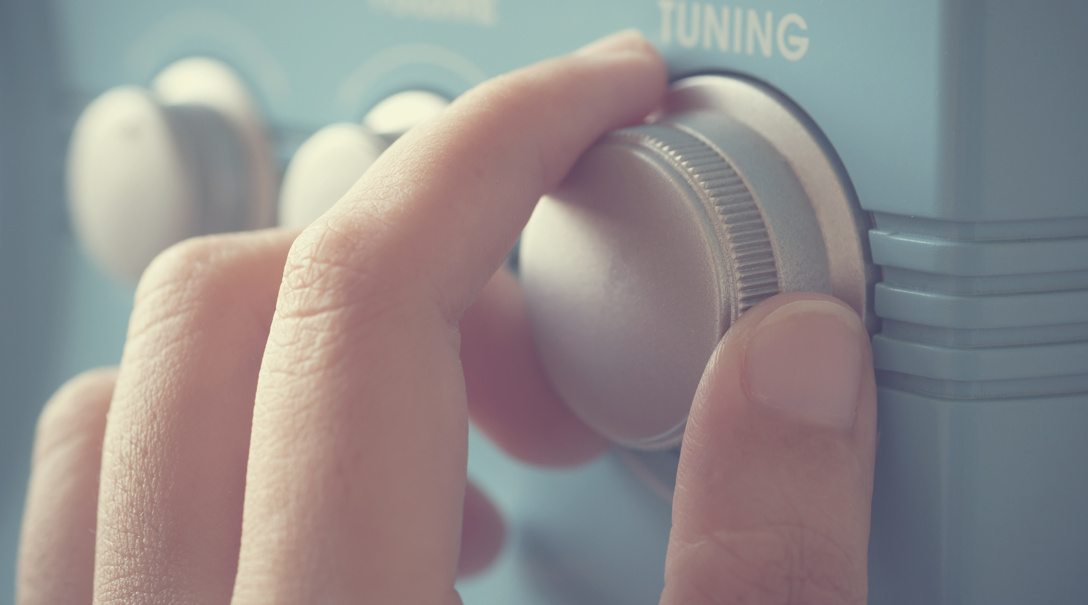
DIGITAL RADIO USE IN SWITZERLAND Trend analysis autumn 2023 Digital Migration Working Group, Moritz Büchi

Slide 2
Switzerland listens to the radio digitally
80% of all radio minutes listened to are via digital radio.
Radio usage volume (in per cent) by mode of reception
Digital
Analogue
± 1.5
Example: the maximum sampling error of ± 1.5 percentage points (pp) at a confidence level of 95% means that the proportion of analogue radio usage would fall between 18.5% and 21.5% in 95% of cases if the survey were repeated.
Source: GfK Switzerland, DigiMig survey, n(2015/2)=2’453, n(2016/1)=2’526, n(2016/2)=2’531, n(2017/1)=2’504, n(2017/2)=2’519, n(2018/1)=2’673, n(2018/2)=2’761, n(2019/1)=2’740, n(2019/2)=2’800 , n(2020/1)=2’625, n(2020/2)=2’671, n(2021/1): 2’670, n(2021/2)=2’801, n(2022/1)=2’789, n(2022/2)=2’841, n(2023/1)=2’756), n(2023/2)=2’725

Slide 3
Stabilisation of usage share by mode of reception
41 out of every 100 minutes of radio listened to are via DAB+, 39% via internet and 20% via FM radio.
Radio usage volume (in per cent) by mode of reception
± 1.8 Pp
± 1.8 Pp
Radio use via TV (6% of total use) is assigned to the internet / Digital category.
± 1.5 Pp
Sampling error (confidence level = 95%) in percentage points
Source: GfK Switzerland, DigiMig survey, n(2015/2)=2’453, n(2016/1)=2’526, n(2016/2)=2’531, n(2017/1)=2’504, n(2017/2)=2’519, n(2018/1)=2’673, n(2018/2)=2’761, n(2019/1)=2’740, n(2019/2)=2’800 , n(2020/1)=2’625, n(2020/2)=2’671, n(2021/1): 2’670, n(2021/2)=2’801, n(2022/1)=2’789, n(2022/2)=2’841, n(2023/1)=2’756), n(2023/2)=2’725

Slide 4
Radio use by language region
LANGUAGE REGION
DAB+ usage is highest in German-speaking Switzerland while in French-speaking Switzerland it is internet radio.
Radio usage (in per cent) by mode of reception and language region
German-speaking
French-speaking
Italian-speaking
± 2.3
± 3.7
± 5.9
± 2.3
± 3.5
± 6.0
± 1.8
± 3.3
± 5.5
Analogue/FM
Internet/ Digital
Sampling error (confidence level = 95%) in percentage points
Source: GfK Switzerland, DigiMig survey, n(2023/2)=2’725); (n[DS, 2023/2]=1’777, n[SR, 2023/2]=694, n[SI, 2023/2]=254)

Slide 5
Radio use by age
AGE
Radio listening via internet is most popular among the younger two age groups. Among the 55+ age group, DAB+ is the most popular mode of radio reception at 44%.
Radio use (in per cent) by mode of reception and age group
15-34
35-54
55+
± 2.7
± 4.0
± 3.1
± 2.9
± 3.8
± 3.1
± 3.0
± 2.5
± 2.4
Analogue/FM
Internet/ Digital
Sampling error (confidence level = 95%) in percentage points
Source: GfK Switzerland, DigiMig survey, n(2023/2)=2’725; (n[15-34, 2023/2]=612, n[35-54, 2023/2]=978, n[55+, 2023/2]=1’135)

Slide 6
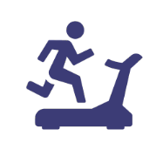
Radio use by location
PLACE OF USE
Radio use is greatest at home, accounting for 63 of every 100 minutes of listening time. Use at work accounts for 18 of every 100 minutes, while in-car listening makes up 13 minutes. These figures have been stable for several years now.
Radio usage (in per cent) by mode of reception and usage location
Home
65%
± 1.8
The figures represent total radio usage on stationary and mobile devices by usage location
Work
19%
± 1.4
Car
12%
± 1.3
On the go
Sport
Other
Sampling error (confidence level = 95%) in percentage points
Source: GfK Switzerland, DigiMig survey, n(2023/2)=2’725)
Notes:
jeweils durch JALL angepasst, note to self: Quelle nicht vergessen

Slide 7
Radio use by location and mode of reception
PLACE OF USE
At home, DAB+ and internet are used more or less to the same extent, at work, internet radio is the most popular mode of reception. In the car DAB+ is the clear leader where a total of 68 out of 100 minutes of radio listening are digital.
Radio usage (in per cent) by mode of reception and usage location
-29
+17
+12
Change compared to 2015/2 in percentage points
Home
-30
+12
+17
Work
-39
+35
FACTS
FACTS
Car
The majority of DAB+ use takes place at home: 62% of DAB+ use overall. 18% of DAB+ radio use is in the car and 17% is at the place of work or education.
In terms of share, listening via FM radio is still most popular in the car (33%) compared to at home or at work, while listening via internet is still relatively rare in the car (13%). Of all the radio minutes listened to, DAB+ is the preferred mode of reception with 55% (in the car) and approx. 40% (at home and at work).
On the go
Sports
Other
Source: GfK Switzerland, DigiMig survey, n(2023/2)=2’725)

Slide 8
Penetration by mode of reception
Reichweiten
77% of the population use digital radio. Of this share, 40% also use FM radio. The proportion of digital-only radio users is 46%; 10% say that they use FM exclusively.
Share of transmission vectors (in per cent)
FACTS
FACTS
FM
Σ= 41%
± 1.1
10%
The distribution of the individual reception modes is slowly shifting away from FM towards digital reception modes.
77% of the population use digital radio (DAB+ or IP/TV). Almost half of the population (46%) use digital radio exclusively.
41% of the population still use analogue radio – at least partially or in one location – and 31% in combination with digital reception modes; 10% of people say they listen to radio exclusively via FM.
12% use Internet radio exclusively, 14% only use DAB+ to listen to the radio.
-34
-14
change compared to 2015/2 in percentage points
± 1.8
± 1.1
± 1.2
9%
11%
-6
± 1.2
-13
11%
-1
IP/TV
Σ= 54%
± 1.3
± 1.2
Σ= 54%
14%
± 1.5
12%
20%
+16
+9
+7
+7
± 1.8
+14
± 1.9
digital Radio (IP/TV/DAB+) Σ= 77%
No Radio: 12%
± 1.2
+6
± 1.6
Not classifiable : 2%
+10
± 0.5
-1
Source: GfK Switzerland, DigiMig survey, n(2015/2)=2’453, n(2023/2)=2’725)
Sampling error (confidence level = 95%) in percentage points

Slide 9
Development of user share over time
REACH
10% of the population still listen exclusively to FM Radio. 76% listen to digital radio. Almost half of the population (45%) no longer listens to FM radio, only digital radio..
Share by mode of transmission (in per cent)
Unknown
No Radio
± 1.2
Digital Only
± 1.9
FM & Digital
± 1.7
FM Only
± 1.1
Source: GfK Switzerland, DigiMig survey, n(2015/2)=2’453, n(2016/1)=2’526, n(2016/2)=2’531, n(2017/1)=2’504, n(2017/2)=2’519, n(2018/1)=2’673, n(2018/2)=2’761, n(2019/1)=2’740, n(2019/2)=2’800 , n(2020/1)=2’625, n(2020/2)=2’671, n(2021/1)=2’670, n(2021/2)=2’801, n(2022/1)=2’789, n(2022/2)=2’841, n(2023/1)=2’756), n(2023/2)=2’725
Sampling error (confidence level = 95%) in percentage points

Slide 10
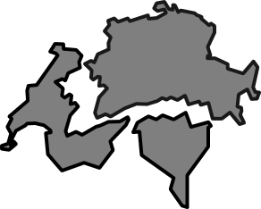
Key Messages
Radio in Switzerland goes digital
80%
of radio usage
is digital
+31
percentage
points in 7 years
≥73%
digital use in all
language regions
≥77%
digital use in every
age group
67%
of in-car use
is digital
41%
of the population
use digital radio
exclusively
10%
of the population
still listen only
to FM Radio
Source: GfK Switzerland, DigiMig survey, n(2023/2)=2’725)

