Slide 1
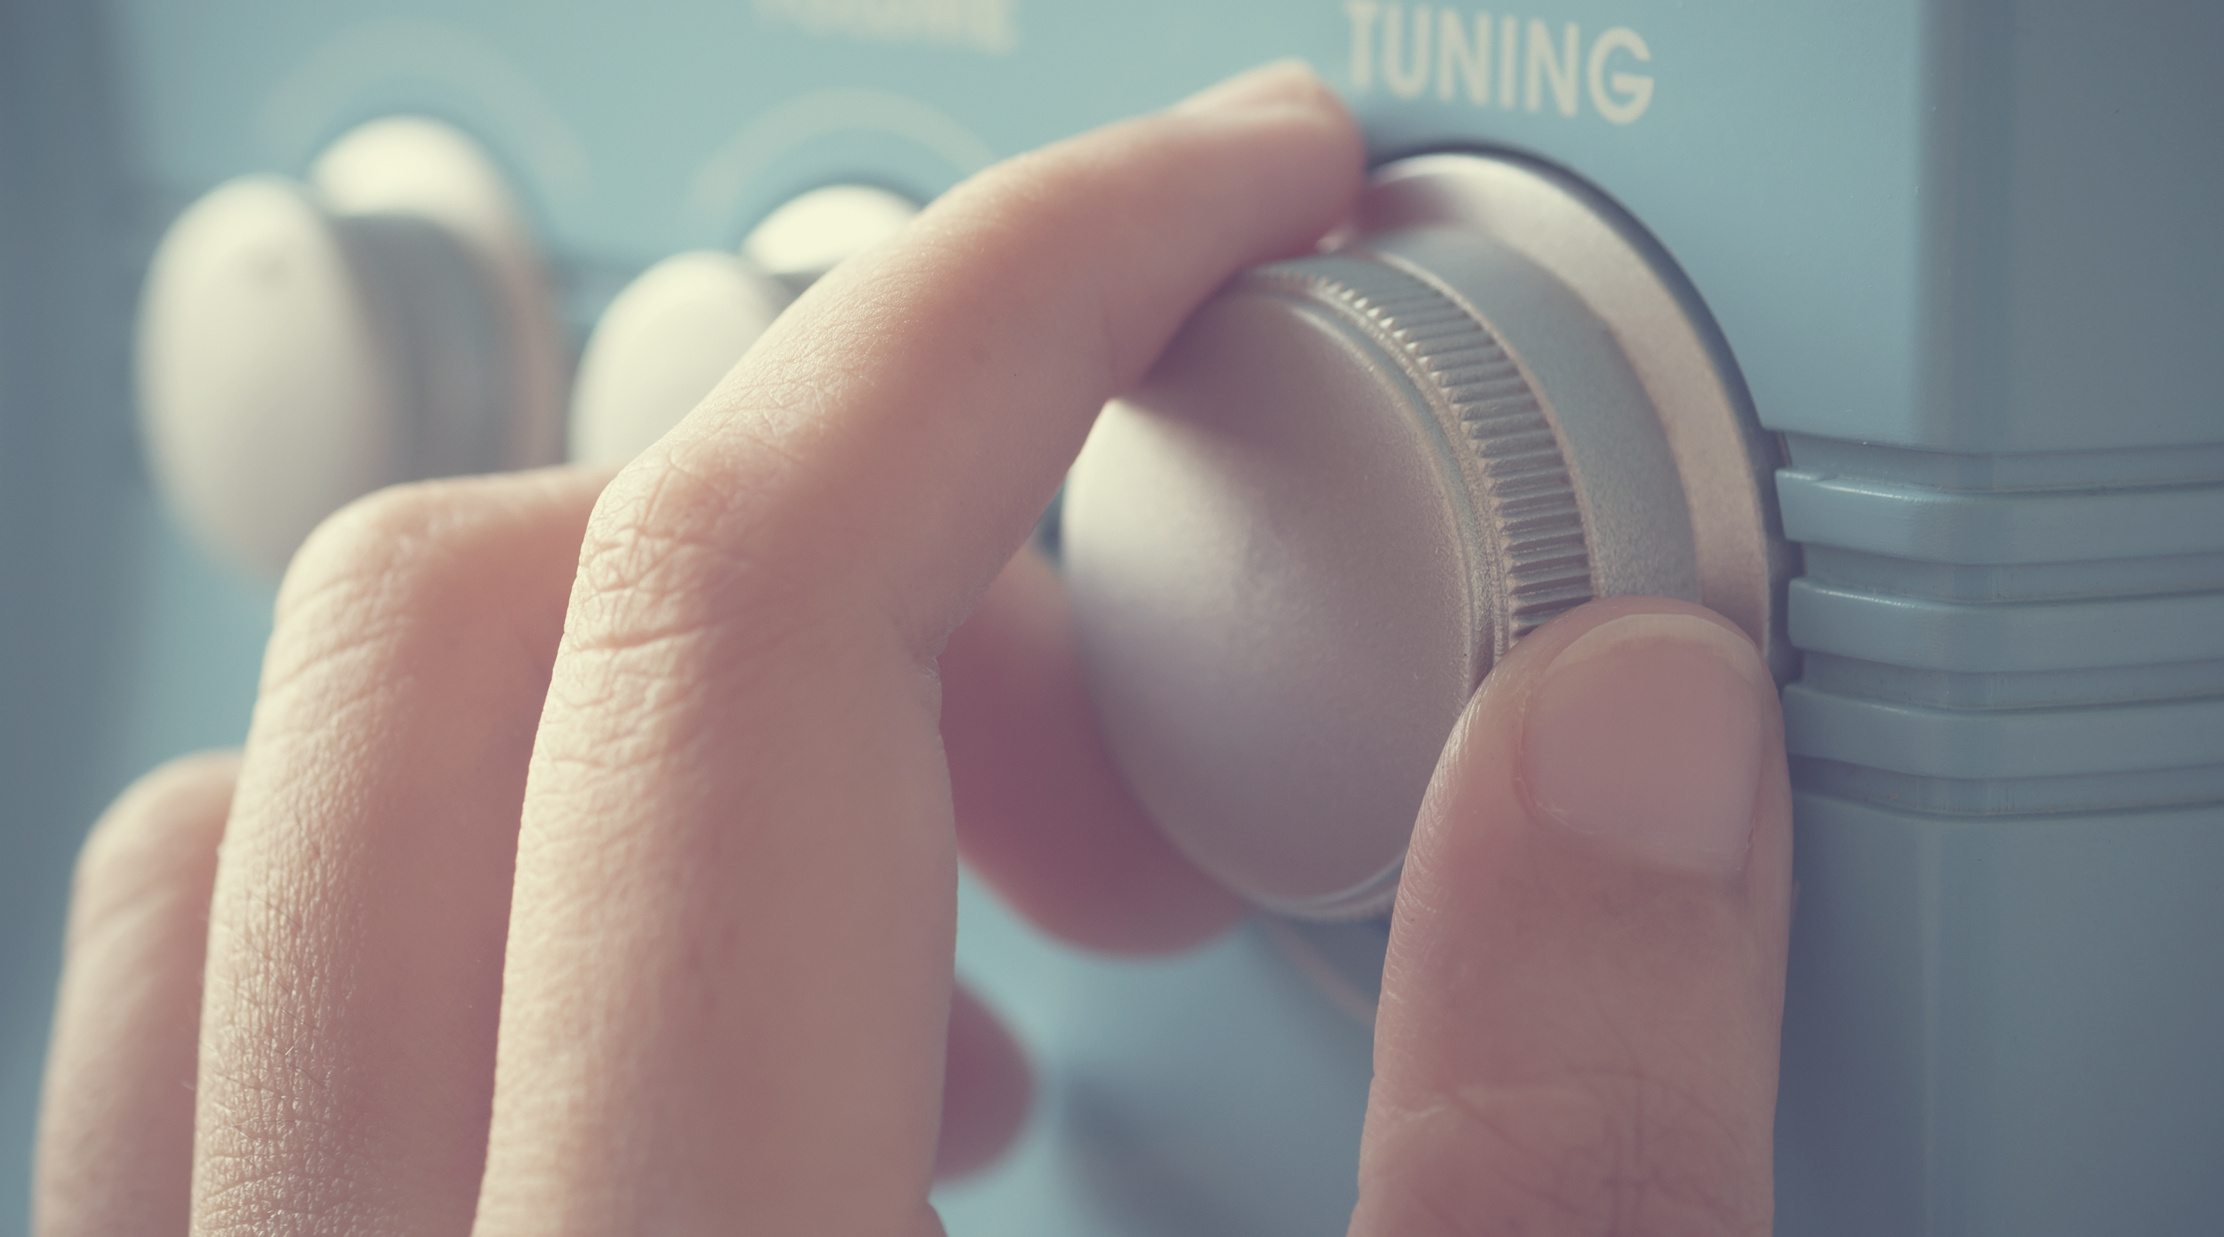
DIGITAL RADIO USE IN SWITZERLAND
Trend analysis autumn 2024
Digital Migration Working Group, Moritz Büchi
Notes:
Geliefert von Bastian GfK: 29.11.2024
Geprüft/ergänzt von Moritz für Digimig: 12.12.2024
Publiziert ab ARaRo: **.02.2025

Slide 2



Switzerland listens to the radio digitally
83% of all radio minutes listened to are via digital radio.
Radio usage volume (in per cent) by mode of reception
Digital
Analogue
± 1.5
Example: the maximum sampling error of ± 1.5 percentage points (pp) at a confidence level of 95% means that the proportion of analogue radio usage would fall between 15.5% and 18.5% in 95% of cases if the survey were repeated.
Source: GfK Switzerland, DigiMig survey, n(2015/2)=2’453, n(2016/1)=2’526, n(2016/2)=2’531, n(2017/1)=2’504, n(2017/2)=2’519, n(2018/1)=2’673, n(2018/2)=2’761, n(2019/1)=2’740, n(2019/2)=2’800 , n(2020/1)=2’625, n(2020/2)=2’671, n(2021/1): 2’670, n(2021/2)=2’801, n(2022/1)=2’789, n(2022/2)=2’841, n(2023/1)=2’756), n(2023/2)=2’725, n(2024/1)=2’575

Slide 3

Stabilisation of usage share by mode of reception
42 out of every 100 minutes of radio listened to are via DAB+, 41% via internet and 17% via FM radio.
Radio usage volume (in per cent) by mode of reception
± 1.9 Pp
± 1.9 Pp
Radio use via TV (6% of total use)
is assigned to the internet / Digital category.
± 1.5 Pp
Sampling error (confidence level = 95%) in percentage points
Source: GfK Switzerland, DigiMig survey, n(2015/2)=2’453, n(2016/1)=2’526, n(2016/2)=2’531, n(2017/1)=2’504, n(2017/2)=2’519, n(2018/1)=2’673, n(2018/2)=2’761, n(2019/1)=2’740, n(2019/2)=2’800 , n(2020/1)=2’625, n(2020/2)=2’671, n(2021/1): 2’670, n(2021/2)=2’801, n(2022/1)=2’789, n(2022/2)=2’841, n(2023/1)=2’756), n(2023/2)=2’725, n(2024/1)=2’575

Slide 4



Radio use by language region
LANGUAGE REGION
DAB+ usage is highest in German-speaking Switzerland while in French-speaking Switzerland it is internet radio.
Radio usage (in per cent) by mode of reception and language region
German speaking
French speaking
Italian speaking
± 2.4
± 3.7
± 5.7
± 2.4
± 3.5
± 5.8
± 1.8
± 2.9
± 5.1
FM
Internet/
Digital
Sampling error (confidence level = 95%) in percentage points
Source: GfK Switzerland, DigiMig survey, n(2024/1)=2’575); (n[DS, 2024/1]=1’607, n[SR, 2024/1]=696, n[SI, 2024/1]=272)

Slide 5



Radio use by age
AGE
Radio listening via internet is most popular among the younger two age groups. Among the 55+-age group DAB+ is the most popular mode of radio reception at 50%.
Radio use (in per cent) by mode of reception and age group
15-34
35-54
55+
± 2.8
± 4.0
± 3.2
± 3.0
± 3.8
± 3.1
± 2.6
± 2.4
± 2.4
FM
Internet/
Digital
Sampling error (confidence level = 95%) in percentage points
Source: GfK Switzerland, DigiMig survey, n(2024/1)=2’575; (n[15-34, 2024/1]=599, n[35-54, 2024/1]=923, n[55+, 2024/1]=1’053)

Slide 6




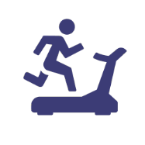

Radio use by location
PLACE OF USE
Radio use is greatest at home, accounting for 60 of every 100 minutes of listening time. Use at work accounts for 20 of every 100 minutes, while in-car listening makes up 14 minutes. These figures have been stable for several years now.
Radio usage (in per cent) by mode of reception and usage location
Home
65%
± 1.9
The figures
represent total
radio usage on stationary and
mobile devices by usage location
Work
19%
± 1.5
Car
12%
± 1.3
Sport
On the go
Other
Sampling error (confidence level = 95%) in percentage points
Source: GfK Switzerland, DigiMig survey, n(2024/1)=2’575
Notes:
jeweils durch JALL angepasst, note to self: Quelle nicht vergessen

Slide 7


Radio use by location and mode of reception
PLACE OF USE
At home and at work DAB+ and internet radio are used more or less to the same extent. In the car DAB+ is the clear leader where a total of 72 out of 100 minutes of radio listening are digital.
Radio usage (in per cent) by mode of reception and usage location
-32
+18
+14
Change compared to
2015/2 in percentage points
Home
-36
+17
+19
Work
-45
+33
FACTS
FACTS
Car
The majority of DAB+ use takes place at home: 58% of DAB+ use overall. 21% of DAB+ radio use is at the place of work or education and 17% is in the car.
In terms of share, listening via FM radio is still most popular in the car (27%) compared to at home or at work, while listening via internet is still relatively rare in the car (19%). Of all the radio minutes listened to, DAB+ is the preferred mode of reception with 53% (in the car) and approx. 40% (at home and at work).
Sport
On the go
Other
Source: GfK Switzerland, DigiMig survey, n(2024/1)=2’575

Slide 8


Penetration by mode of reception
REACH
80% of the population use digital radio. Of this share, 36% also use FM radio. The proportion of digital-only radio users is 51%; 8% say that they use FM exclusively.
Share of transmission vectors (in per cent)
FACTS
FACTS
FM
Σ= 37%
± 1.0
8%
The distribution of the individual reception modes is slowly shifting away from FM towards digital reception modes.
80% of the population use digital radio (DAB+ or IP/TV). . Half of the population (51%) use digital radio exclusively.
36% of the population still use analogue radio – at least partially or in one location – and 29% in combination with digital reception modes; 8% of people say they listen to radio exclusively via FM.
12% use Internet radio exclusively, 16% only use DAB+ to listen to the radio.
-38
-16
change compared to 2015/2 in percentage points
± 1.9
± 1.0
± 1.2
8%
10%
-7
± 1.2
-14
11%
-1
IP/TV
Σ= 55%
± 1.4
± 1.3
Σ= 58%
16%
± 1.5
12%
23%
+20
+11
+7
+8
± 1.9
+17
± 1.9
digital Radio (IP/TV/DAB+)
Σ= 79%
No Radio: 10%
± 1.2
+4
± 1.6
Not classifiable: 2%
+12
± 0.5
-1
Source: GfK Switzerland, DigiMig survey, n(2015/2)=2’453, n(2024/1)=2’575)
Sampling error (confidence level = 95%) in percentage points
Notes:
Hallo Moritz,
Der genaue Wert für Summe aller digital Hörenden ist 79.48%.
Je nachdem, wie die Gruppen aufsummiert dargestellt werden (Summe aller digitalen [S.8] vs. Aufteilung auf Digital only und mixed [S.9]), kann aufgrund Rundungsproblematik 1% mal verloren/gewonnen werden.
Liebe Grüsse
––
Bastian Ruggle

Slide 9
Development of user share over time
REACH
8% of the population still listen exclusively to FM Radio. 80% listen to digital radio. Half of the population (51%) no longer listens to FM radio, only digital radio.
Share by mode of transmission (in per cent)
unknown
No Radio
± 1.2
Digital Only
± 1.9
FM & Digital
± 1.8
FM Only
± 1.0
Source: GfK Switzerland, DigiMig survey, n(2015/2)=2’453, n(2016/1)=2’526, n(2016/2)=2’531, n(2017/1)=2’504, n(2017/2)=2’519, n(2018/1)=2’673, n(2018/2)=2’761, n(2019/1)=2’740, n(2019/2)=2’800 , n(2020/1)=2’625, n(2020/2)=2’671, n(2021/1)=2’670, n(2021/2)=2’801, n(2022/1)=2’789, n(2022/2)=2’841, n(2023/1)=2’756), n(2023/2)=2’725, n(2024/1)=2’575
Sampling error (confidence level = 95%) in percentage points

Slide 10

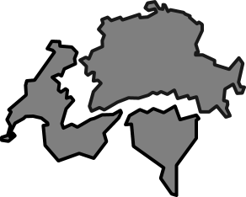


Key Messages
Radio in Switzerland goes digital
83%
of radio usage is digital
+34
percentage
points in
9 years
≥75%
digital use in all
language regions
≥81%
digital use in every age group
72%
of in-car use
is digital
42%
of the population
use digital radio
exclusively
8%
of the population still listen only to FM Radio
Source: GfK Switzerland, DigiMig survey, n(2024/1)=2’575)

